Slide 1
INTEGRAL CALCULUS AND ORDINARY DIFFERENTIAL EQUATIOSNS
MULTIPLE INTEGRATION

Slide 2
Multiple Integration
Multiple Integration: The integrals of functions of more than one variable are known as multiple integrals and are evaluated by a process involving iterated integrals.
Partial Integration: The process in which the integration is performed with respect to one variable treating the other variable(s) as constant is called partial integration.
Iterated Integral: A definite integral which is evaluated stage by stage using partial integration is called an iterated (successive or repeated) integral.

Slide 3
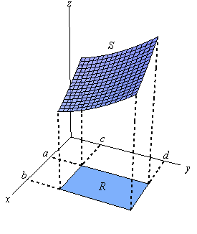
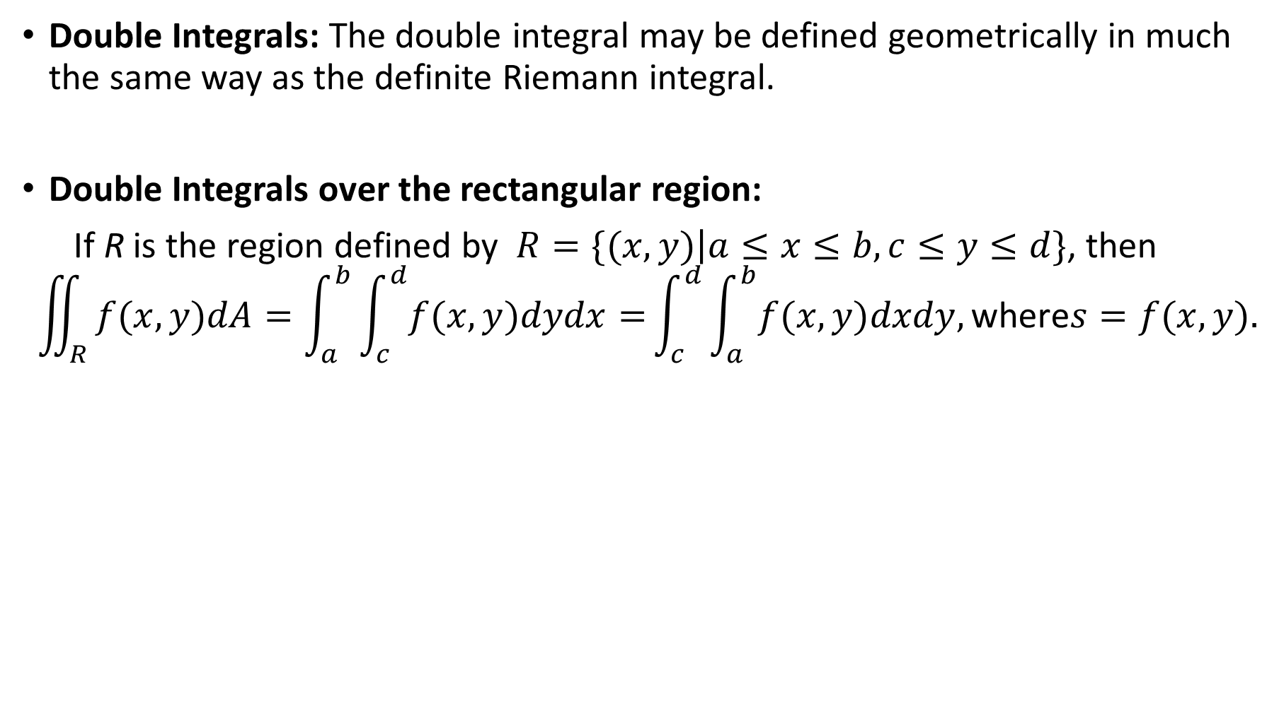
Double Integrals: The double integral may be defined geometrically in much the same way as the definite Riemann integral.
Double Integrals over the rectangular region:
If R is the region defined by $R=\{(x,y)\left|a≤x≤b,c≤y≤d\}\right.$, then
$$\iint_{R}{f(x,y)dA=\int_{a}^{b}{\int_{c}^{d}{f(x,y)dydx=}}\int_{c}^{d}{\int_{a}^{b}{f(x,y)dxdy,\text{where}s=f(x,y).}}}$$

Slide 4
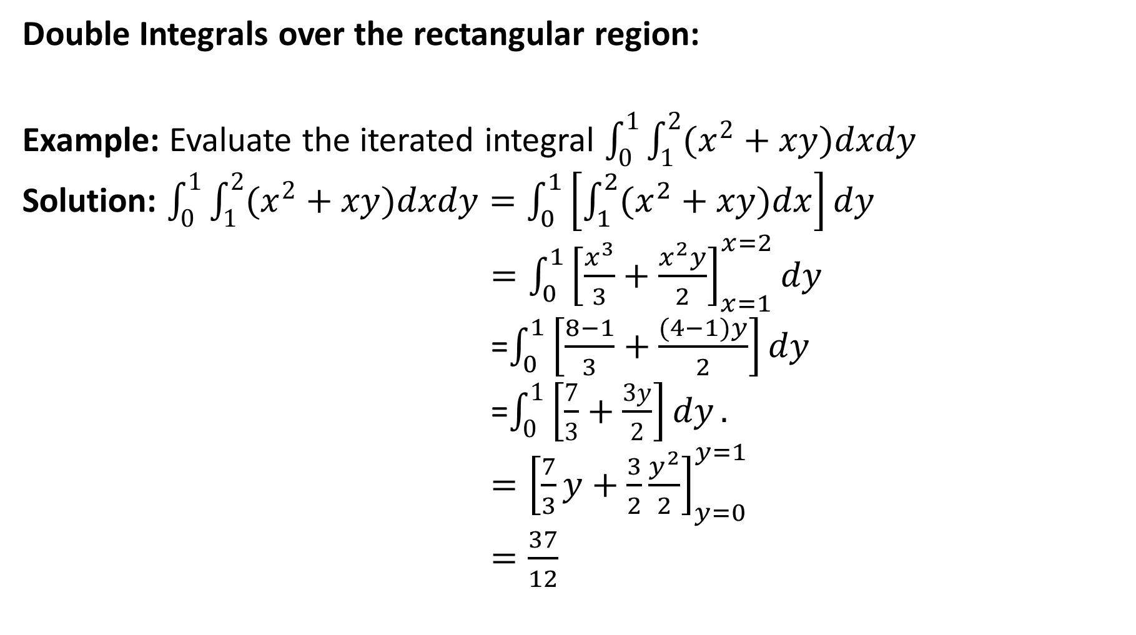
Double Integrals over the rectangular region:
Example: Evaluate the iterated integral $\int_{0}^{1}{\int_{1}^{2}{(x^{2}+xy)dxdy}}$
Solution: $\int_{0}^{1}{\int_{1}^{2}{(x^{2}+xy)dxdy}=\int_{0}^{1}{\left[\int_{1}^{2}{(x^{2}+xy)dx}\right]dy}}$
$=\int_{0}^{1}{{\left[\frac{x^{3}}{3}+\frac{x^{2}y}{2}\right]}_{x=1}^{x=2}dy}$
=$\int_{0}^{1}{\left[\frac{8−1}{3}+\frac{(4−1)y}{2}\right]dy}$
=$\int_{0}^{1}{\left[\frac{7}{3}+\frac{3y}{2}\right]dy}.$
$={\left[\frac{7}{3}y+\frac{3}{2}\frac{y^{2}}{2}\right]}_{y=0}^{y=1}$
$=\frac{37}{12}$

Slide 5
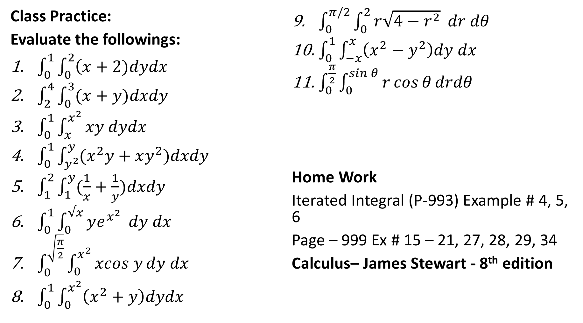
Class Practice:
Evaluate the followings:
$\int_{0}^{1}{\int_{0}^{2}{\left(x+2)dydx\right.}}$
$\int_{2}^{4}{\int_{0}^{3}{(x+y)dxdy}}$
$\int_{0}^{1}{\int_{x}^{x^{2}}{xy dydx}}$
$\int_{0}^{1}{\int_{y^{2}}^{y}{(x^{2}y+xy^{2})dxdy}}$
$\int_{1}^{2}{\int_{1}^{y}{(\frac{1}{x}+\frac{1}{y})dxdy}}$
$\int_{0}^{1}{\int_{0}^{√x}{ye^{x^{2}}}} dy dx$
$\int_{0}^{\sqrt{\frac{π}{2}}}{\int_{0}^{x^{2}}{xcos y}dy dx}$
$\int_{0}^{1}{\int_{0}^{x^{2}}{\left(x^{2}+y\right)dydx}}$
$\int_{0}^{π/2}{\int_{0}^{2}{r\sqrt{4−r^{2}}} dr dθ}$
$\int_{0}^{1}{\int_{−x}^{x}{\left(x^{2}−y^{2}\right)dy dx}}$
$\int_{0}^{\frac{π}{2}}{\int_{0}^{\sin{θ}}{r\cos{θ}drdθ}}$
Home Work
Iterated Integral (P-993) Example # 4, 5, 6
Page – 999 Ex # 15 – 21, 27, 28, 29, 34
Calculus– James Stewart - 8th edition

Slide 6
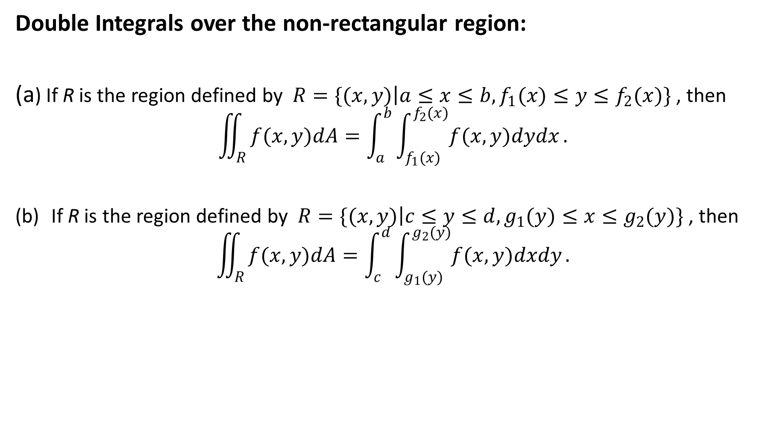
Double Integrals over the non-rectangular region:
(a) If R is the region defined by $R=\{(x,y)\left|a≤x≤b,f_{1}(x)≤y≤f_{2}(x)\}\right.$ , then
$$\iint_{R}{f(x,y)dA=\int_{a}^{b}{\int_{f_{1}(x)}^{f_{2}(x)}{f(x,y)dydx}}.}$$
If R is the region defined by $R=\{(x,y)\left|c≤y≤d,g_{1}(y)≤x≤g_{2}(y)\}\right.$ , then
$$\iint_{R}{f(x,y)dA=\int_{c}^{d}{\int_{g_{1}(y)}^{g_{2}(y)}{f(x,y)dxdy}}.}$$

Slide 7
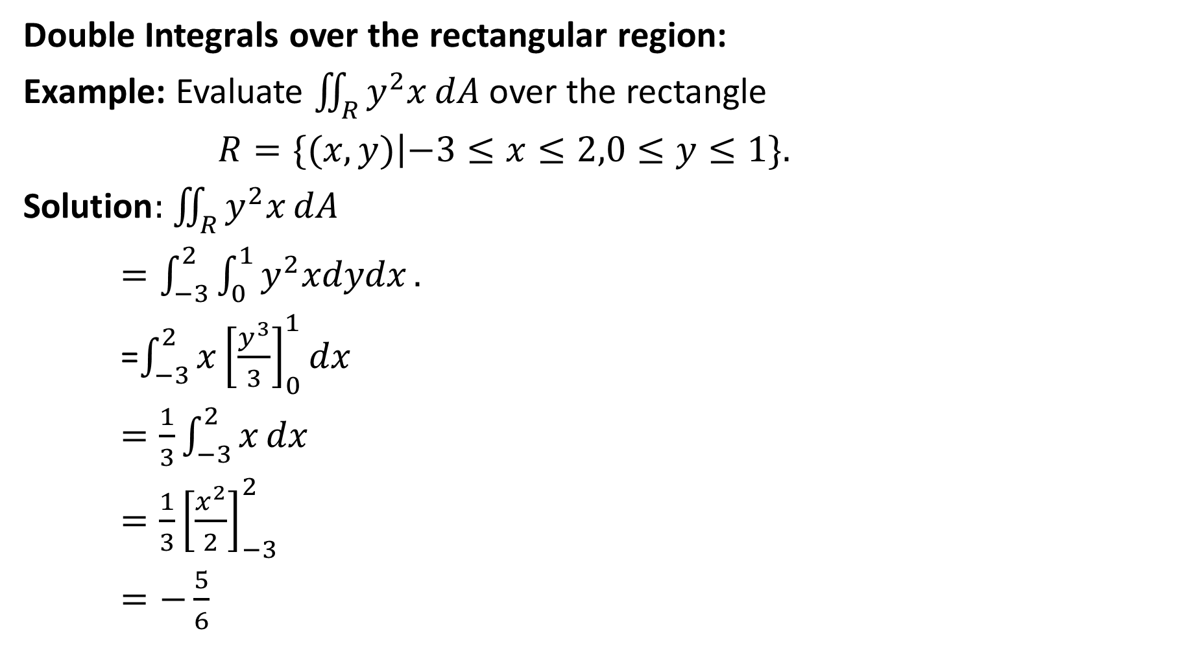
Double Integrals over the rectangular region:
Example: Evaluate $\iint_{R}{y^{2}x}dA$ over the rectangle
$R=\{(x,y)\left|−3≤x≤2,0≤y≤1\}.\right.$
$\text{Solution}:$ $\iint_{R}{y^{2}x}dA$
$=\int_{−3}^{2}{\int_{0}^{1}{y^{2}xdydx}}.$
=$\int_{−3}^{2}{x{\left[\frac{y^{3}}{3}\right]}_{0}^{1}dx}$
$=\frac{1}{3}\int_{−3}^{2}{x}dx$
$=\frac{1}{3}{\left[\frac{x^{2}}{2}\right]}_{−3}^{2}$
$=−\frac{5}{6}$

Slide 8
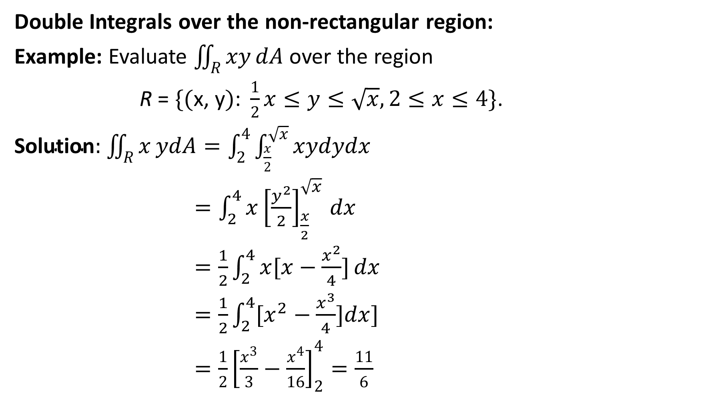
Double Integrals over the non-rectangular region:
Example: Evaluate $\iint_{R}{xy}dA$ over the region
R = $\{(\text{x}\text{, }\text{y})\text{: }\frac{1}{2}x≤y≤\sqrt{x},2≤x≤4\}$.
$\text{Solution}:$ $\iint_{R}{x}ydA=\int_{2}^{4}{\int_{\frac{x}{2}}^{\sqrt{x}}{xydydx}}$
${=\int_{2}^{4}{x}\left[\frac{y^{2}}{2}\right]}_{\frac{x}{2}}^{\sqrt{x}}dx$
$=\frac{1}{2}\int_{2}^{4}{x[x−\frac{x^{2}}{4}]}dx$
$=\frac{1}{2}\int_{2}^{4}{[x^{2}−\frac{x^{3}}{4}]dx]}$
$=\frac{1}{2}{\left[\frac{x^{3}}{3}−\frac{x^{4}}{16}\right]}_{2}^{4}=\frac{11}{6}$

Slide 9
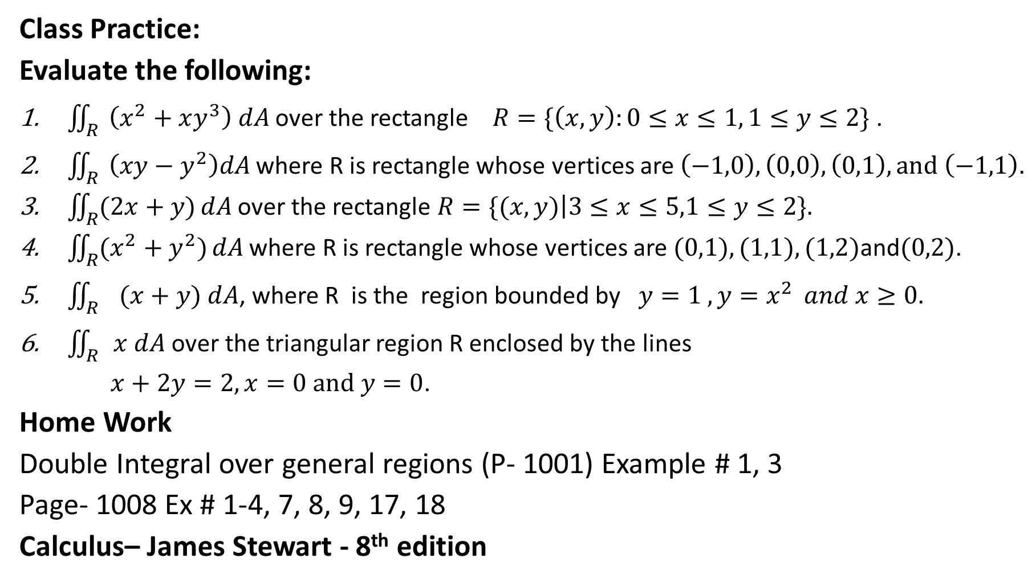
Class Practice:
Evaluate the following:
$\iint_{R}{\left(x^{2}+xy^{3}\right) dA}$ over the rectangle $R=\{\left(x,y\right):0≤x≤1, 1≤y≤2\}$ .
$\iint_{R}{\left(xy−y^{2}\right)dA}$ where R is rectangle whose vertices are $\left(−1,0\right), \left(0,0\right), \left(0,1\right), and \left(−1,1\right).$
$\iint_{R}{(2x+y)}dA$ over the rectangle $R=\{(x,y)\left|3≤x≤5,1≤y≤2\}.\right.$
$\iint_{R}{(x^{2}+y^{2})}dA$ where R is rectangle whose vertices are $(0,1),(1,1),(1,2)\text{and}(0,2)$.
$\iint_{R}{ (x+y) dA}$, where R is the region bounded by $y=1 , y=x^{2 } and x≥0.$
$\iint_{R}{x dA}$ over the triangular region R enclosed by the lines
$x+2y=2, x=0 and y=0$.
Home Work
Double Integral over general regions (P- 1001) Example # 1, 3
Page- 1008 Ex # 1-4, 7, 8, 9, 17, 18
Calculus– James Stewart - 8th edition

Slide 10
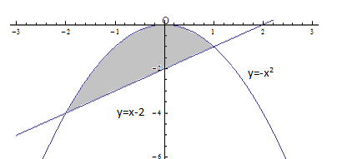
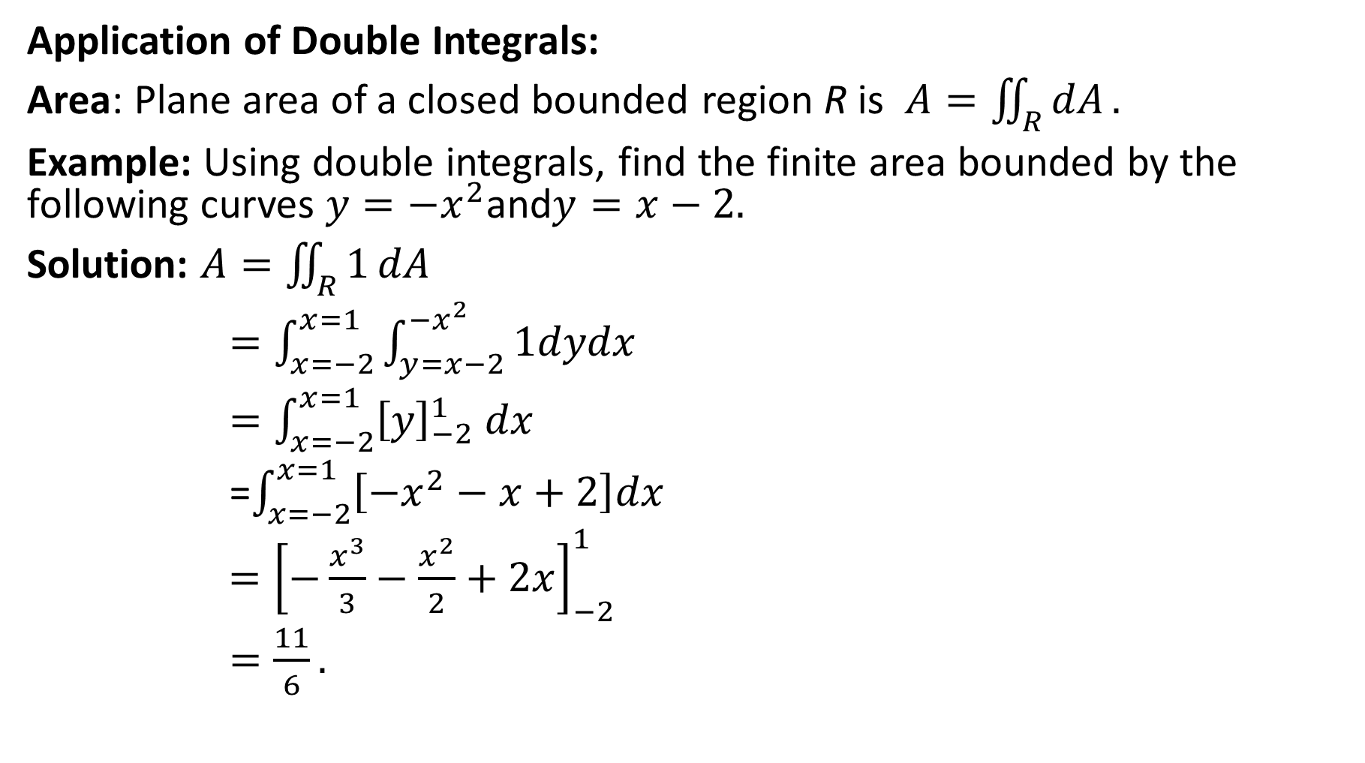
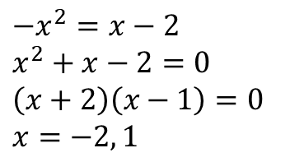
Application of Double Integrals:
Area: Plane area of a closed bounded region R is $A=\iint_{R}{dA}.$
Example: Using double integrals, find the finite area bounded by the following curves $y=−x^{2}\text{and}y=x−2.$
Solution: $A=\iint_{R}{1}dA$
$=\int_{x=−2}^{x=1}{\int_{y=x−2}^{−x^{2}}{1dydx}}$
$=\int_{x=−2}^{x=1}{{\left[y\right]}_{−2}^{1} dx}$
=$\int_{x=−2}^{x=1}{\left[−x^{2}−x+2\right]dx}$
$={\left[−\frac{x^{3}}{3}−\frac{x^{2}}{2}+2x\right]}_{−2}^{1}$
$=\frac{11}{6}.$
$$−x^{2}=x−2$$
$$x^{2}+x−2=0$$
$$\left(x+2\right)\left(x−1\right)=0$$
$$x=−2, 1$$

Slide 11
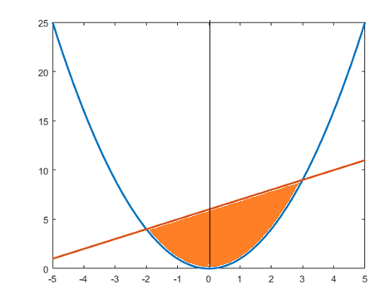
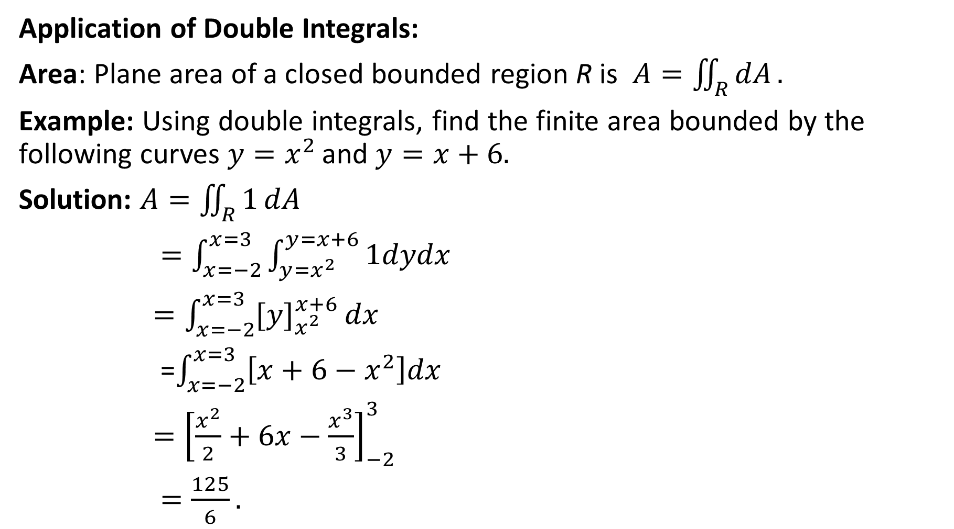
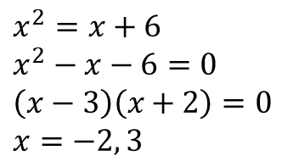
Application of Double Integrals:
Area: Plane area of a closed bounded region R is $A=\iint_{R}{dA}.$
Example: Using double integrals, find the finite area bounded by the following curves $y=x^{2 }\text{and} y=x+6.$
Solution: $A=\iint_{R}{1}dA$
$=\int_{x=−2}^{x=3}{\int_{y=x^{2}}^{y=x+6}{1dydx}}$
$=\int_{x=−2}^{x=3}{{[y]}_{x^{2}}^{x+6}}dx$
=$\int_{x=−2}^{x=3}{\left[x+6−x^{2}\right]dx}$
$={\left[\frac{x^{2}}{2}+6x−\frac{x^{3}}{3}\right]}_{−2}^{3}$
$=\frac{125}{6}.$
$$x^{2}=x+6$$
$$x^{2}−x−6=0$$
$$\left(x−3\right)\left(x+2\right)=0$$
$$x=−2, 3$$

Slide 12

Class Practice:
Sketch the region and using double integrals, find the finite area bounded by the following curve (s).
$y=2x−x^{2}$ and x-axis
$x^{2}=4y,$ $8y=x^{2}+16$
$y=−x, x=0, y=2$

Slide 13
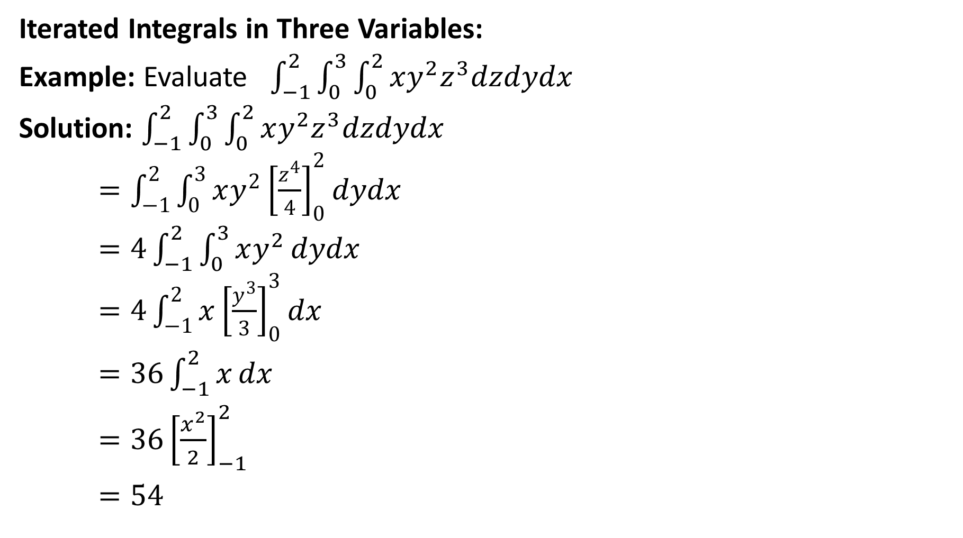
Iterated Integrals in Three Variables:
Example: Evaluate $\int_{−1}^{2}{\int_{0}^{3}{\int_{0}^{2}{xy^{2}z^{3}dzdydx}}}$
Solution: $\int_{−1}^{2}{\int_{0}^{3}{\int_{0}^{2}{xy^{2}z^{3}dzdydx}}}$
$={\int_{−1}^{2}{\int_{0}^{3}{xy^{2}\left[\frac{z^{4}}{4}\right]}}}_{0}^{2}dydx$
$=4\int_{−1}^{2}{\int_{0}^{3}{xy^{2}}}dydx$
$=4\int_{−1}^{2}{x}{\left[\frac{y^{3}}{3}\right]}_{0}^{3}dx$
$=36\int_{−1}^{2}{x}dx$
$=36{\left[\frac{x^{2}}{2}\right]}_{−1}^{2}$
$=54$

Slide 14
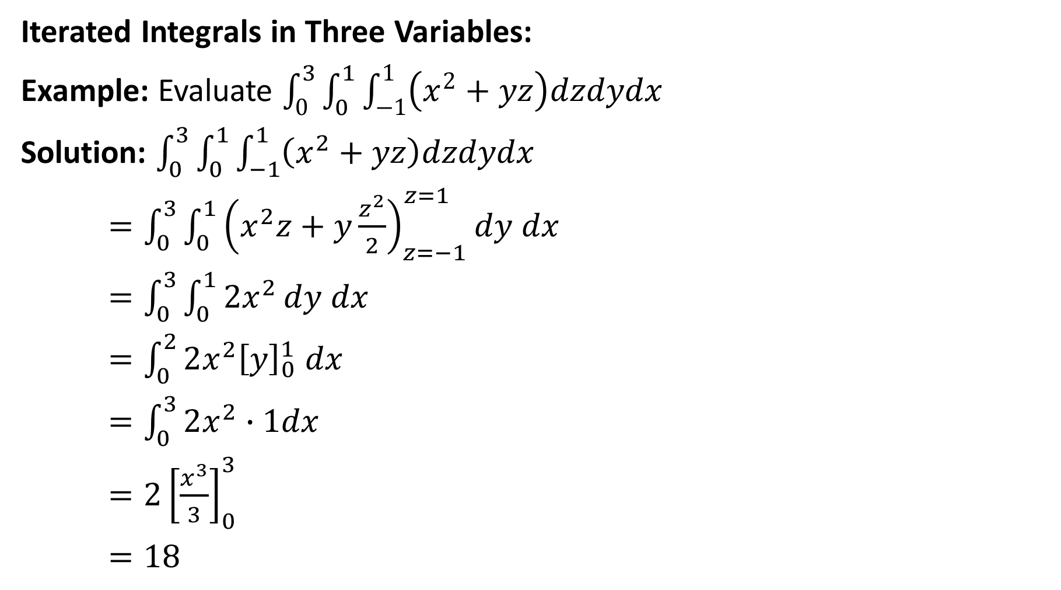
Iterated Integrals in Three Variables:
Example: Evaluate $\int_{0}^{3}{\int_{0}^{1}{\int_{−1}^{1}{\left(x^{2}+yz\right)dzdydx}}}$
Solution: $\int_{0}^{3}{\int_{0}^{1}{\int_{−1}^{1}{\left(x^{2}+yz\right)dzdydx}}}$
$=\int_{0}^{3}{\int_{0}^{1}{{\left(x^{2}z+y\frac{z^{2}}{2}\right)}_{z=−1}^{z=1}}dy dx}$
$=\int_{0}^{3}{\int_{0}^{1}{2x^{2}}dy dx}$
$=\int_{0}^{2}{2x^{2}{\left[y\right]}_{0}^{1} dx}$
$=\int_{0}^{3}{2x^{2}∙1dx}$
$=2{\left[\frac{x^{3}}{3}\right]}_{0}^{3}$
$=18$

Slide 15

Class Practice:
Evaluate the following iterated integral
$\int_{0}^{2}{\int_{−3}^{0}{\int_{−1}^{1}{\left(x^{2}+yz\right)dzdydx}}}$
$\int_{1}^{2}{\int_{0}^{1}{\int_{−1}^{1}{(x^{2}+y^{2}+z^{2})dxdydz}}}$
$\int_{0}^{1}{\int_{0}^{y^{2}}{\int_{0}^{x+y}{ x} dzdxdy}}$
$\int_{0}^{1}{\int_{0}^{x}{\int_{0}^{x−y}{xdzdydx}}}$
$\int_{0}^{2}{\int_{−1}^{y^{2}}{\int_{−1}^{z}{yzdxdzdy}}}$
$\int_{0}^{2π}{\int_{0}^{2}{\int_{0}^{4−r^{2}}{zr} }}dzdrdθ$
$\int_{0}^{2π}{\int_{0}^{π}{\int_{0}^{a}{r^{3}\sin{θ drdθdφ}}}}$,
Home Work
Triple Integral (P-1030) Example # 1
Page- 1037 Ex # 3-7

Slide 16
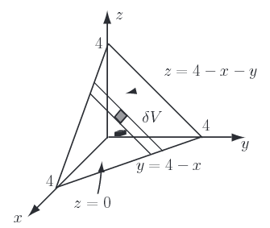
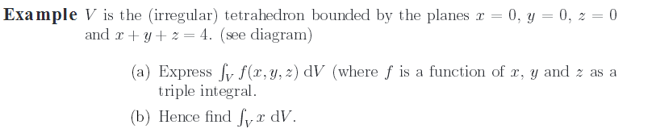
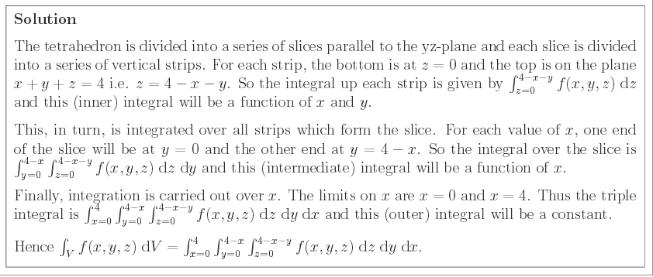

Application of Triple Integrals:
The volume of a closed bounded region R in space is $V=\iiint_{R}{dV}.$

Slide 17
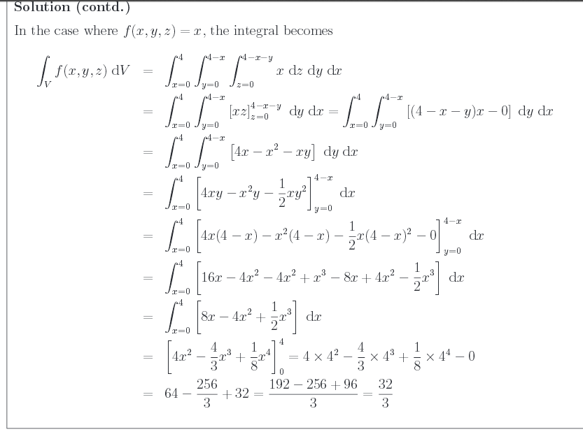
Home Work
Triple Integral (P- 1034) Volume Example # 5
Page 1038 Ex# 19-22

Slide 18
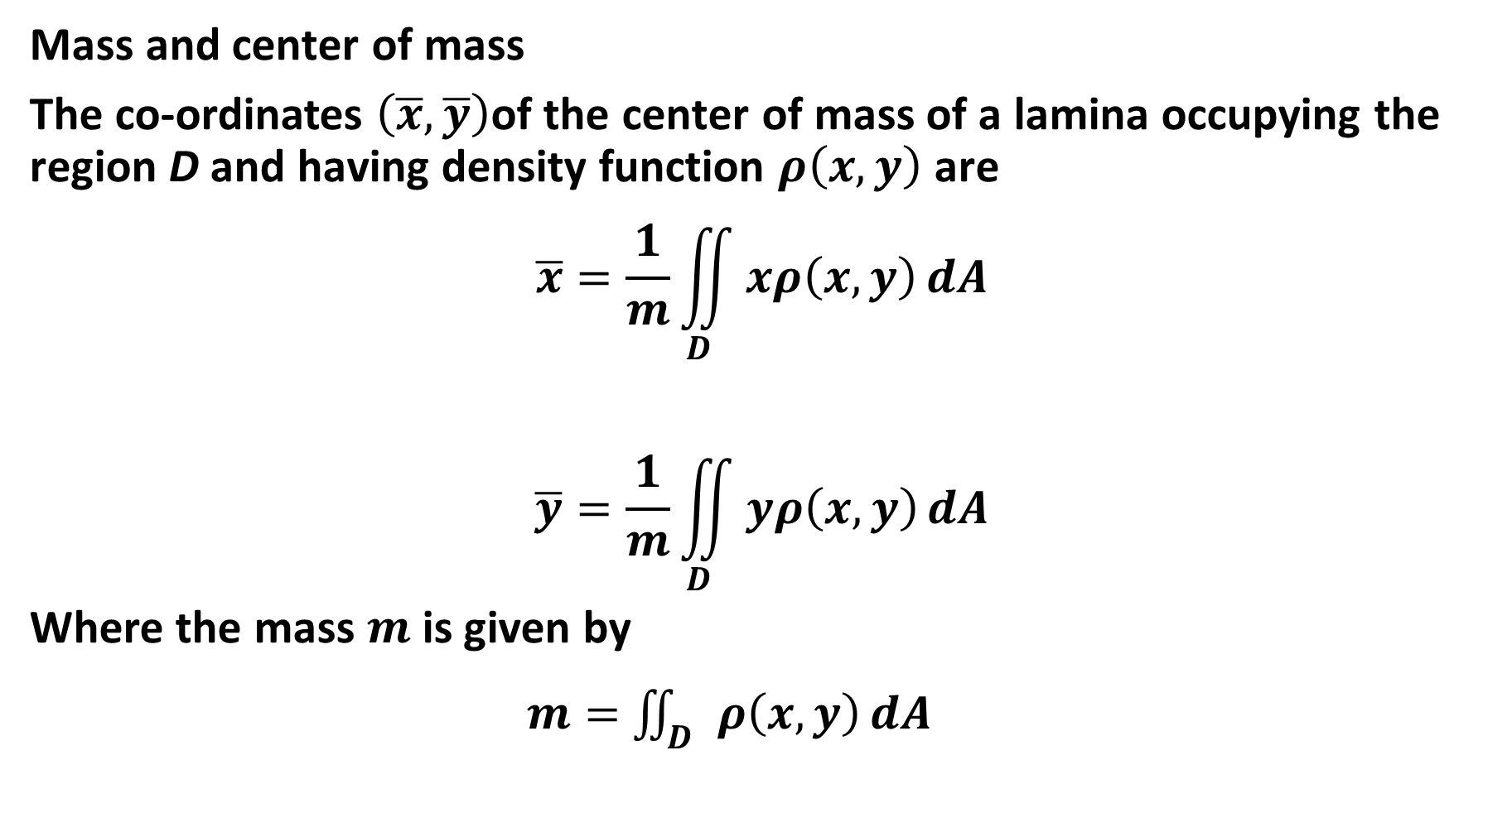
Mass and center of mass
The co-ordinates $\left(\overline{x},\overline{y}\right)$of the center of mass of a lamina occupying the region D and having density function $ρ\left(x,y\right)$ are
$$\overline{x}=\frac{1}{m}\iint_{D}{xρ\left(x,y\right)}dA$$
$$\overline{y}=\frac{1}{m}\iint_{D}{yρ\left(x,y\right)}dA$$
Where the mass $m$is given by
$m=$ $\iint_{D}{ρ\left(x,y\right)}dA$

Slide 19
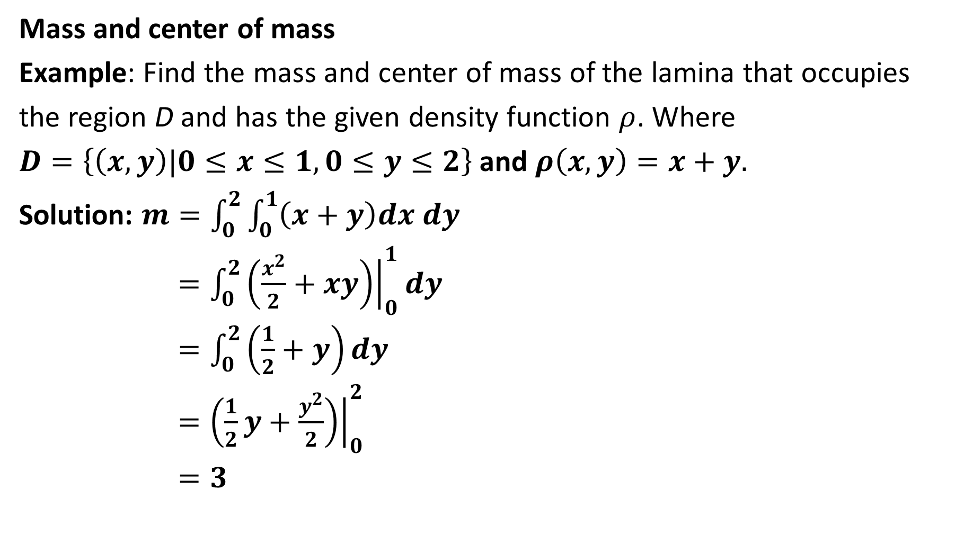
Mass and center of mass
Example: Find the mass and center of mass of the lamina that occupies
the region D and has the given density function $ρ$. Where
$D=\left\{\left(x,y\right)|0≤x≤1, 0≤y≤2\right\}$ and $ρ\left(x,y\right)=x+y.$
Solution: $m=\int_{0}^{2}{\int_{0}^{1}{\left(x+y\right)dx dy}}$
$=\int_{0}^{2}{{\left.\left(\frac{x^{2}}{2}+xy\right)\right|}_{0}^{1}dy}$
$=\int_{0}^{2}{\left(\frac{1}{2}+y\right)dy}$
$={\left.\left(\frac{1}{2}y+\frac{y^{2}}{2}\right)\right|}_{0}^{2}$
$=3$

Slide 20

Mass and center of mass
$\overline{x}=\frac{1}{m}\iint_{D}{xρ\left(x,y\right)}dA$
$\overline{x}=\frac{1}{3}\int_{0}^{2}{\int_{0}^{1}{x\left(x+y\right)dx dy}}$
$=\frac{1}{3}\int_{0}^{2}{\int_{0}^{1}{\left(x^{2}+xy\right)dx dy}}$
=$\frac{1}{3}{\int_{0}^{2}{\left.\left(\frac{x^{3}}{3}+\frac{x^{2}}{2}y\right)\right|}}_{0}^{1}dy$
` $=\frac{1}{3}\int_{0}^{2}{\left(\frac{1}{3}+\frac{1}{2}y\right)dy}$
$=\frac{1}{3}{\left.\left(\frac{1}{3}y+\frac{1}{2}\frac{{ y}^{2}}{2}\right)\right|}_{0}^{2}$
$=\frac{5}{9}$

Slide 21

Mass and center of mass
$\overline{y}=\frac{1}{m}\iint_{D}{yρ\left(x,y\right)}dA$
$\overline{y}=\frac{1}{3}\int_{0}^{2}{\int_{0}^{1}{y\left(x+y\right)dx dy}}$
$=\frac{1}{3}\int_{0}^{2}{\int_{0}^{1}{\left(xy+y^{2}\right)dx dy}}$
=$\frac{1}{3}{\int_{0}^{2}{\left.\left(\frac{x^{2}}{2}y+xy^{2}\right)\right|}}_{0}^{1}dy$
` $=\frac{1}{3}\int_{0}^{2}{\left(\frac{1}{2}y+y^{2}\right)dy}$
$=\frac{1}{3}{\left.\left(\frac{1}{2}\frac{y^{2}}{2}+\frac{{ y}^{3}}{3}\right)\right|}_{0}^{2}$
$=\frac{11}{9}$

Slide 22
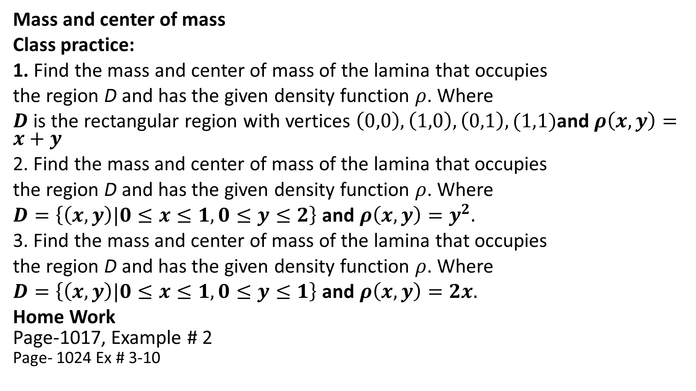
Mass and center of mass
Class practice:
1. Find the mass and center of mass of the lamina that occupies
the region D and has the given density function $ρ$. Where
$D$ is the rectangular region with vertices $\left(0,0\right),\left(1,0\right),\left(0,1\right),(1,1)$and $ρ\left(x,y\right)=x+y$
2. Find the mass and center of mass of the lamina that occupies
the region D and has the given density function $ρ$. Where
$D=\left\{\left(x,y\right)|0≤x≤1, 0≤y≤2\right\}$ and $ρ\left(x,y\right)=y^{2}.$
3. Find the mass and center of mass of the lamina that occupies
the region D and has the given density function $ρ$. Where
$D=\left\{\left(x,y\right)|0≤x≤1, 0≤y≤1\right\}$ and $ρ\left(x,y\right)=2x.$
Home Work
Page-1017, Example # 2
Page- 1024 Ex # 3-10

Slide 23

Double Integration in polar co-ordinate
Suppose that we want to evaluate a double integral$\iint_{R}{f\left(x,y\right)dA}$, where R is one of the regions shown in Figure. In either case the description of R in terms of rectangular coordinates is rather complicated, but R is easily described using polar coordinates.

Slide 24

The polar coordinates $(r,θ)$ of a point are related to the rectangular
coordinates $(x,y)$ by the equations
$r^{2}=x^{2}+y^{2}$
$$x=r\cos{θ}$$
$$y=r\sin{θ}$$

Slide 25

Change to Polar Coordinates in a Double Integral
If $f$ is continuous in a polar rectangle $R$ given by $a≤r≤b$, $α≤θ≤β$
Then
$$\iint_{R}{f\left(x,y\right)dA}=\int_{α}^{β}{\int_{a}^{b}{f(r\cos{θ, rsin θ)r dr dθ}}}$$

Slide 26

Example: Evaluate $\iint_{R}{e^{−(x^{2}+y^{2})}dA}$ where $R$ is the annulus
$x^{2}+y^{2}≥1$, $x^{2}+y^{2}≤4.$
Solution: $\iint_{R}{e^{−(x^{2}+y^{2})}dA}$
$=\int_{θ=0}^{θ=2π}{\int_{r=1}^{r=2}{e^{−r^{2}}r dr dθ}}$
$=−\int_{0}^{2π}{{(e}^{−4}−e^{−1}) dθ}$
$=$ ${2π(e}^{−1}−e^{−4})$

Slide 27
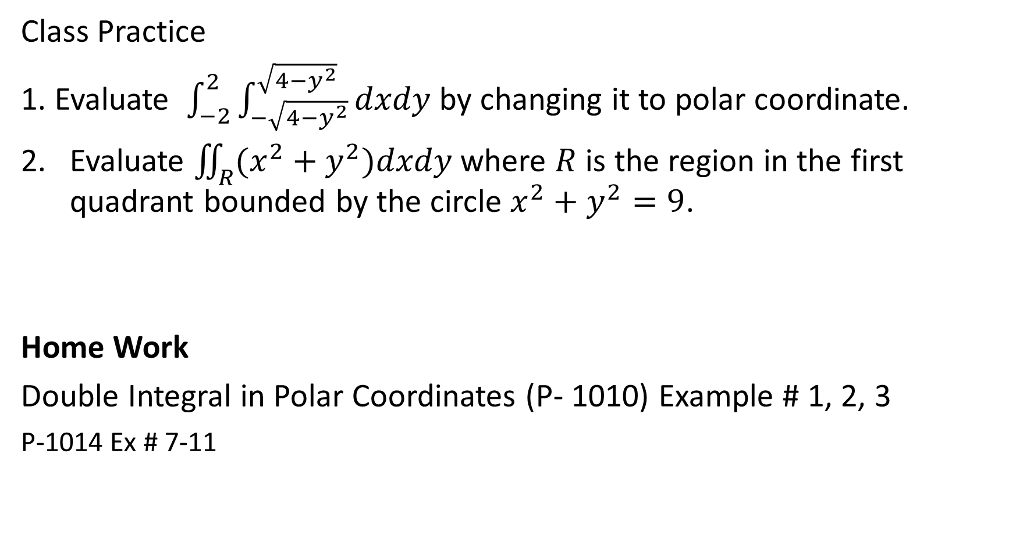
Class Practice
1. Evaluate $\int_{−2}^{2}{\int_{−\sqrt{4−y^{2}}}^{\sqrt{4−y^{2}}}{dxdy}}$ by changing it to polar coordinate.
Evaluate $\iint_{R}{(x^{2}+y^{2})dxdy}$ where $R$ is the region in the first quadrant bounded by the circle $x^{2}+y^{2}=9$.
Home Work
Double Integral in Polar Coordinates (P- 1010) Example # 1, 2, 3
P-1014 Ex # 7-11

Slide 28
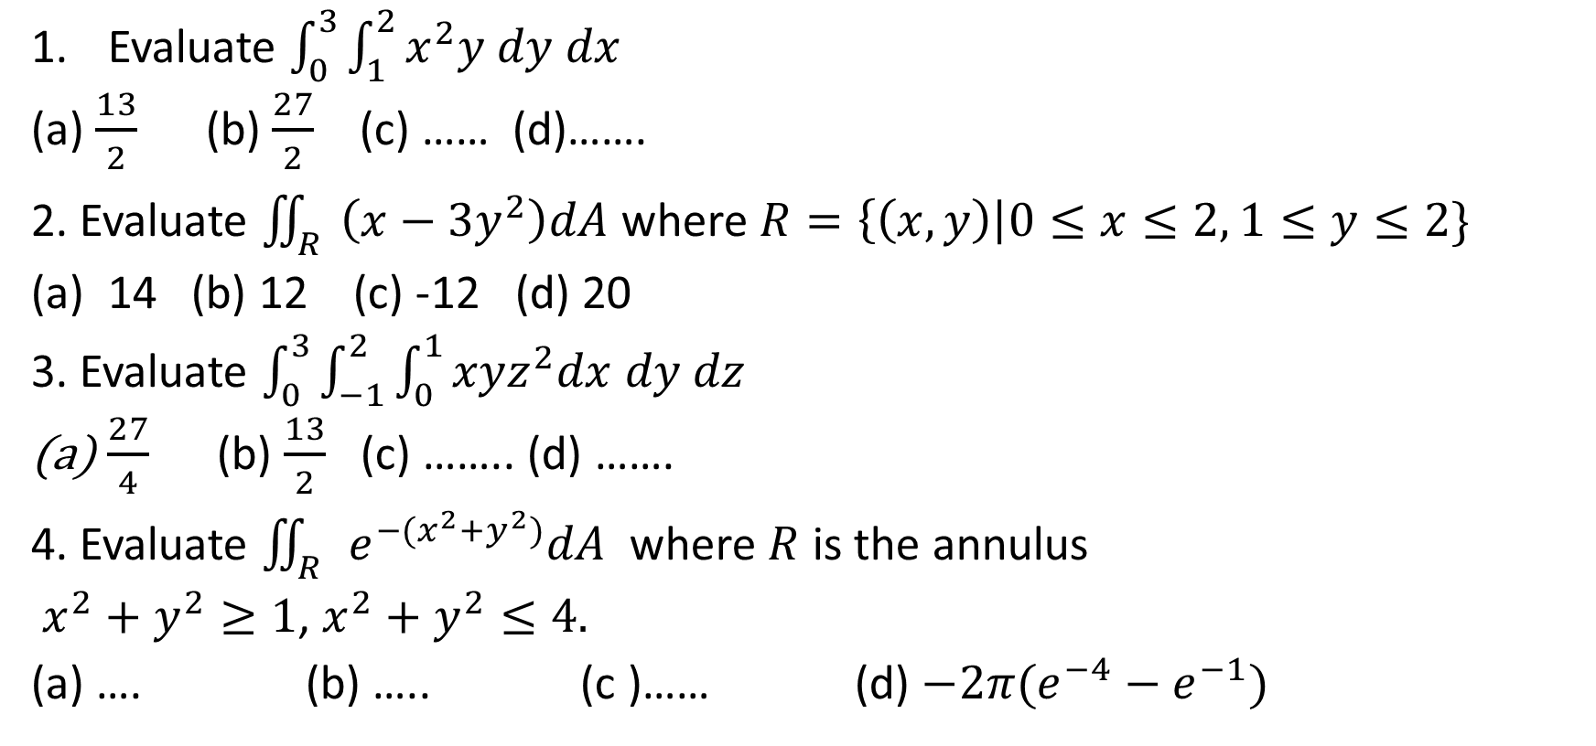
Sample MCQ
Evaluate $\int_{0}^{3}{\int_{1}^{2}{x^{2}y dy dx}}$
(a) $\frac{13}{2}$ (b) $\frac{27}{2}$ (c) …… (d)…….
2. Evaluate $\iint_{R}{\left(x−3y^{2}\right)dA}$ where $R=\left\{\left(x,y\right)\right|0≤x≤2, 1≤y≤2\}$
14 (b) 12 (c) -12 (d) 20
3. Evaluate $\int_{0}^{3}{\int_{−1}^{2}{\int_{0}^{1}{xyz^{2}dx dy dz}}}$
$\frac{27}{4}$ (b) $\frac{13}{2}$ (c) …….. (d) …….
4. Evaluate $\iint_{R}{e^{−(x^{2}+y^{2})}dA}$ where $R$ is the annulus
$x^{2}+y^{2}≥1$, $x^{2}+y^{2}≤4.$
(a) …. (b) ….. (c )…… (d) ${−2π(e}^{−4}−e^{−1})$

